Slide 1
Cognizant Cloud Services
Azure AD Application Proxy for on-premises apps
Saurav Kumar Saha

Slide 2
Agenda
Scenario
Due Diligence
01
A Brief Description of the scenario and Problem Statement
02
In depth analysis of the client environment
Solution Framework
Features
03
Designed solution based on factors like Client requirement , Microsoft guidelines, Cost Optimization, Security compliance, lower TCO , High stability
04
Explanation of all the features which we have proposed in Solution Framework.
Architectural Diagram
Prerequisites
05
Layout of how the proposed solution would work.
06
List of things that should be in place before we start the implementation.
Steps Required
Challenges & Mitigation
07
High Level Steps & detailed technical steps.
08
Challenges faced and mitigation plans.
Best practices & pricing
Pro’s and Con’s
09
Best practices to comply with Microsoft guidelines.
10
Pros and cons for using Azure AD Application proxy.

Slide 3
Introduction
Scenario & Discussion
This use case will describe how we have leveraged Azure AD Application Proxy feature to fulfill one of our client’s requirement. While discussing the deployment scenario and our solution approach, we will also cover Features, Prerequisites and Best Practices related to Application Proxy. This use case will act as a reference document for other architects, who will be deploying Application Proxy in some other environment. Reference links to Microsoft documents have been provided for further reading.
The organization is having a number of on premises applications spread across different geographical locations.
They want that the users can securely access these on premises applications over the Internet.
Want to implement SSO feature to improve user sign-in experience.
They are expecting a solution which will involve low cost, management overhead and is less complex to implement.
The solution should involve minimum configuration changes for network and firewall rules.

Slide 4
Due Diligence
On analyzing the customer environment we found the following information:
Organization is having a single forest & single domain environment ABC.org.
Applications are spread across 3 different geographical locations APAC, Europe and US.
All the applications are using Windows Internal Authentication(WIA) for authentication purpose.
Organization is already using Azure AD Basic edition. Users are synced from on premises using pass-through authentication.
Since they are using PTA they already have Azure verified domain.
At present the users are using VPN to access these application from outside corporate network.

Slide 5
Solution
Why Azure AD Application proxy ?
We are going to use Azure AD Application proxy to access the on premises applications.
It is cost effective as the TCO (total cost of ownership) is greatly reduced.
Consistent management with Windows workloads: Retraining of IT staff not needed as it contains all the necessary features.
Designed and built on modern security standards: It does not store passwords in memory adding another layer of security to the systems.
ABC corporation is already having Azure AD Basic Edition which is having application proxy feature.
Since applications are spread across multiple locations and networks we recommend to use Application Proxy Connector Groups.
We will enable SSO to enhance user sign-in experience by configuring Kerberos Constrained Delegation.
A software-based solution that is simple to deploy, maintain, and scale unlike VPN.

Slide 6
Feature- Azure AD Application Proxy
Simple
No need to rewrite applications
Users get a consistent authentication experience. They can use the MyApps portal to get single sign-on to both SaaS apps in the cloud and our apps on-premises.
Secure
We can take advantage of the rich authorization controls and security analytics in Azure.
Cost Effective
We get cloud-scale security and Azure security features like conditional access and two-step verification.
It also supports Single Sign-on (SSO) feature, and there is no modification required in the application side to enable SSO.
Application Proxy works in the cloud, so there is no management overhead involved. On-premises solutions typically requires setting up and maintain DMZs, edge servers, or other complex infrastructures

Slide 7
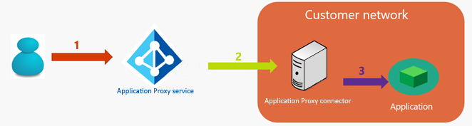
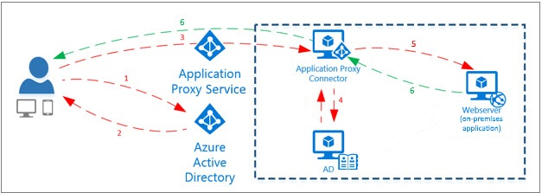
Architectural Diagram
The user accesses the application through the Application Proxy service and is directed to the Azure AD sign-in page to authenticate.
After a successful sign-in, a token is generated and sent to the client device.
The client sends the token to the Application Proxy service, which retrieves the user principal name (UPN) and service principal name (SPN) from the token, then directs the request to the Application Proxy connector.
If you have configured single sign-on, the connector performs any additional authentication required on behalf of the user.
The connector sends the request to the on-premises application.
The response is sent through Application Proxy service and connector to the user.

Slide 8
Prerequisites
Subscriptions
Azure AD basic or premium subscription.
Port Requirements
80: Used for downloading certificate revocation lists (CRLs) while validating the SSL certificate.
DNS Whitelisting
If DNS whitelisting not supported we need to ensure that access to the list of Azure Datacenter IP ranges are allowed, which are updated each week.
Azure AD directory with global administrator privileges.
443: All outbound communication with the Application Proxy service.
A server running Windows Server 2012 R2 or 2016 on which Application Proxy connector can be installed.
URL Access
Access to the following URLs are needed for verifying certificates:
mscrl.microsoft.com:80
crl.microsoft.com:80
ocsp.msocsp.com:80
www.microsoft.com:80
Access to login.windows.net and login.microsoftonline.com for the registration process of connector.
If DNS whitelisting is supported then connections to msappproxy.net & servicebus.windows.net should be whitelisted.
Apps Supported
Web apps which uses Integrated Windows Authentication.
Web applications which uses form based or header-based applications.
Web APIs that we want to expose to rich applications on different devices.
Apps hosted behind a remote desktop gateway.
Rich client apps which are integrated with ADAL.

Slide 9
Steps Required to Perform the Scenario
High Level Steps
Install and Configure the Application Proxy Connector on the prepared on premises server.
For HA purpose we need to install multiple server and also install application proxy connectors based on different applications and locations.
The proxy connector server should be trusted for delegation for SSO.
Publish the on-premises application by providing the internal application URL.
Detailed Technical Steps

Slide 10
Challenges & Mitigation
Challenges | Explanation | Mitigation
Registration page not visible | While registering the application connector the page might not be visible. | We must ensure that IE Enhanced security should be is off.
Application page does not display correctly for an Application Proxy application | Only pages under root are accessible when accessing the application. For example if we have published a logistics application using the internal URL: http://myapps/logistics but the app is using the stylesheet http://myapps/style.css. | The file needs to be placed under the root directory myapps/logistics root directory.
"Can't Access this Corporate Application" error when using an Application Proxy application | We need to check the status code of the error. It can be one of the following: Gateway Timeout Bad Gateway Forbidden | Gateway Timeout: This error occurs when the application Proxy service is unable to reach the connector. We might need to check the required ports and troubleshoot issues related to network. Bad Gateway: This error occurs when the connector is unable to reach the backend application. We might need to check the configuration of the application. Forbidden: This error occurs because of access issues. We need to check whether the user trying accessing the application is assigned to the application in Azure AD.

Slide 11
Best Practices
Best Practices | Explanation
Application Latency | After deploying an application using an application proxy we may find that its taking too long to load. The only option we have here is to tweak network topology. Before deploying the application we can check the latency: http://www.azurespeed.com/Azure/Latency
Redirect hardcoded links for apps published with Azure AD Application Proxy | Some apps, were developed with local links embedded in HTML. These links do not work correctly when the app is used remotely. There can be several on-premises apps pointing to each other the application might not behave properly once accessed from outside of office network. Microsoft recommends to configure the external URL to be the same as internal URLs whenever possible using Custom Domains.
Proper configuration of Single Sign On | SSO works for claim-aware applications that trust Azure Active Directory, but we need to make sure that we configure Kerberos constrained delegation properly. We need to ensure that we add the correct SPN value for the application server. This enables the Proxy Connector to impersonate users in AD against the application defined in the list.
Azure AD Pricing
Azure AD type | Price per user per month
Basic | $1.00
Premium 1 | $6.00
Premium 2 | $9.00
Azure AD Application proxy is available in either Basic and Premium editions of Azure AD. Basic or Premium versions are available through a Microsoft Enterprise Agreement, the Open Volume License Programme and the Cloud Solution Providers programme.

Slide 12
Pros
Cons
Security is managed by Microsoft and not administrators managing on-premises environment.
Since the application proxy service is running on cloud we do not have to worry about maintenance, scalability & downtime.
No need to make any changes in the firewall for incoming traffic as the connector makes outbound connections to the application proxy service running on cloud.
Connector groups can be used for different applications which gives the connectors of the same application HA.
Azure AD Application proxy only supports web protocols such as port 80/443. It cannot be used for applications which are having client server model and uses different protocols and ports.
Azure Application proxy service is not applicable to all the datacenters & to reduce the latency we can take advantage of Microsoft Express Route private peering.
There is no monitoring and alerting mechanism in case the application published using Azure AD application proxy is not accessible. We need to check manually if the application is accessible or down.

Slide 13
Capacity Planning
The more users we have the larger machine we will need running the Application Proxy Connector application. We use a metric called TPS (Transactions per second) as user usage pattern will vary widely and cannot be used to predict load.
Cores | RAM | Expected Latency (MS)-P99 | Max TPS
2 | 8 | 325 | 586
4 | 16 | 320 | 1150
8 | 32 | 270 | 1190
16 | 64 | 245 | 1200*
The machine with Max TPS for 1200 will have a max connection limit of 800. All the other machines are having a connection limit of 200 by default.
More information

Slide 14
NFR’s
Area | Considerations
Availability | MS provides monthly uptime SLA of 99.9% for Azure AD. To increase connector HA we need to configure connector groups.
Azure Verified Domain | If we have a custom domain verified with Azure then in that case we can customize the URLS in the format: http://contoso.com/logistics.
Security | Security for proxy service is managed by Microsoft and the security between the proxy connector and the proxy service is certificate based.
Latency | The proxy service is not available in all the regions and before implementation we need to test the latency from the nearest available data center.

Slide 15
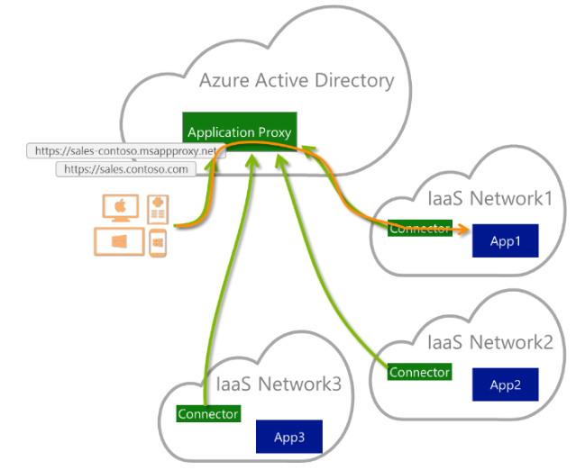
Azure AD Application Proxy Connector configuration
Application proxy connectors can be configured in two ways:
For a specific application: We might have different applications published through application proxy and might need to add connectors for a specific application. We can follow the steps in Azure portal to create new connector group -> Login to Azure portal -> Enterprise Applications -> All Applications -> The application we want to assign a connector group -> Application Proxy-> Connector Group dropdown menu -> Select the group we want the application to use -> Save.
Apps from different networks: We can configure different connectors for different applications running on different networks. We can enable a common service to securely access to all applications without creating additional dependency on our corporate network.

Slide 16
Feature Comparison
Microsoft has provided only two remote access solutions: Azure AD Application Proxy and Web Application Proxy. Web application proxy is used on-premises in ADFS environment. These two solutions mentioned replaces other Microsoft products like Microsoft Forefront Threat Management Gateway (TMG) and Unified Access Gateway (UAG). For most scenarios we can choose Azure AD Application Proxy and Web proxy can only be used as a proxy server for ADFS and can’t be used with custom domains in ADFS.
Feature | TMG | UAG | WAP | AP
Selectively publish browser apps | Yes | Yes | Yes | Yes
Preauthentication and single sign-on | Yes | Yes | Yes | Yes
One portal for application access | - | Yes | - | Yes
Serves as ADFS proxy server | - | Yes | Yes | -
No inbound connections | - | - | - | Yes
Cloud-scale security | - | - | - | Yes
Conditional access | - | Yes | - | Yes
No components in the demilitarized zone (DMZ) | - | - | - | Yes

Slide 17
Reference Articles
TOPICS | LINKS
How Application Proxy works | https://docs.microsoft.com/en-us/azure/active-directory/manage-apps/application-proxy
Installing Application Proxy connector | https://docs.microsoft.com/en-us/azure/active-directory/manage-apps/application-proxy-enable
Publish applications using Azure AD Application Proxy: | https://docs.microsoft.com/en-us/azure/active-directory/manage-apps/application-proxy-publish-azure-portal
Kerberos Constrained delegation for Single Sign-on | https://docs.microsoft.com/en-us/azure/active-directory/manage-apps/application-proxy-configure-single-sign-on-with-kcd
Working with existing proxy server to connect to internet | https://docs.microsoft.com/en-us/azure/active-directory/manage-apps/application-proxy-configure-connectors-with-proxy-servers
Redirect hardcoded links for apps published with Azure AD Application Proxy | https://docs.microsoft.com/en-us/azure/active-directory/manage-apps/application-proxy-configure-hard-coded-link-translation
Application page does not display correctly for an Application Proxy application | https://docs.microsoft.com/en-us/azure/active-directory/application-proxy-page-appearance-broken-problem

Slide 18
Thank you

